Slide 1
Proving the Correctness of Huffman’s Algorithm

Slide 2
Quizz
Suppose we have an alphabet containing 4 characters, {a, b, c, d}.
Which of the following codes could be valid Huffman codes and which not ?
  a=00, b=01, c=10, d=11
  a=0, b=10, c=110, d=111
  a=0, b=10, c=110, d=1111
  a=00, b=01, c=101, d=100

Slide 3
Huffman algorithm
We must prove that the Huffman algorithm always produces optimal codes
A code is optimal for a given source (alphabet with given character frequencies) if the length of the encoded source is smaller or equal with the one produced by any other uniquely-decodable code.

Slide 4
The sibling property
Let C be an alphabet in which each character has a frequency. Let x and y be two characters in C having the lowest frequencies. Then there exists an optimal preﬁx code for C in which the codewords for x and y have the same length and differ only in the last bit (x and y are “siblings”)
Proof: we take the tree T representing an arbitrary optimal preﬁx code and modify it to make a tree representing another optimal preﬁx code such that the characters x and y appear as sibling leaves of maximum depth in the new tree.

Slide 5
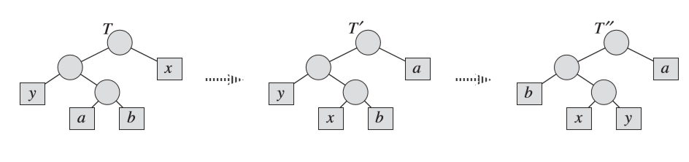
The sibling property (cont)
In the optimal tree T, leaves a and b are two siblings of maximum depth. Leaves x and y are the two characters with the lowest frequencies; they appear in arbitrary positions in T. Swapping leaves a and x produces tree T’, and then swapping leaves b and y produces tree T’’. Since each swap does not increase the cost, the resulting tree T’’ is also an optimal tree.

Slide 6
Huffman algorithm –
Recursive formulation
Procedure RecursiveHufman ( SetOfCharactersWithFreq C)
n = card (C)
if (n<=2)
assign a 1 bit codeword to each character
else
select from C the characters x, y having the minimum frecvencies
create the character z having the frequency freq[x]+freq[y]
create set C’ = C – {x, y} +{z}, card(C’)=n-1
RecursiveHufman(C’)
codeword of x = codeword of z + “1”
codeword of y = codeword of z + ”0”

Slide 7
Huffman - proof
We will prove that the Huffman algorithm produces optimal codes by induction on n, the number of characters of the alphabet
Base case: n=2: each character is encoded using 1 bit, and this is the optimum value (you cannot use less than 1 bit per character)
Inductive Hypothesis:
  Assume that Huffman produces optimal codes for alphabets having n=1, 2, ..., k-1 characters, k>2
Inductive Step:
  Show that Huffman produces optimal codes also for alphabets having n = k characters.

Slide 8
Huffman Proof – Inductive step
For alphabets of size k: Let C={c1, c2, .. ck} be an alphabet having k characters, let x and y be the two least frequent characters. Let L be the length of the code produced when applied to the source of C.
The recursive call will produce a code for C’=C-{x,y}+{z}, an alphabet of k-1 characters, having all frequencies the same as in C, except for freq[z]=freq[x]+freq[y]
By the inductive hypothesis, the code produced for C’ having k-1 characters is optimal. Let its length be L’.
L= L’+freq[x]+freq[y]
  Because the codes for C are exactly the codes for C’, except that one character z is replaced by two other characters x and y, whose codewords are 1 bit longer than the codeword of z. We have to add 1 bit every time z occurs – the frequency of z was freq[x]+freq[y]

Slide 9
Huffman Proof – Inductive step (cont)
In order to prove that the code is optimal for C, we must show that no other code can produce a length LL<L.
Assume (for contradiction) that there is another code such that for C it can produce a code with length LL<L.
In this other code, the codewords for x and y are “siblings”
  The sibling property: there exists an optimal prefix code where the two least frequent characters are encoded by codewords having the same length and that differ only in the last bit
In this other code, we can produce a code for C’, having the length LL’: LL=LL’+freq[x]+freq[y]
Since for C’ we had the optimal code L’, L’<=LL’
LL=LL’+freq[x]+freq[y] >=L’+freq[x]+freq[y] =L
LL >=L is in contradiction with the assumption LL<L, thus no other code can produce a length LL shorter than L for C

